Slide 1
JavaScript

Slide 2
What is JavaScript?
Using HTML we can only design a web page but you can not run any logic on web browser like
addition of two numbers,
check any condition,
looping statements (for, while),
decision making statement (if-else) at client side.
All these are not possible using HTML So for perform all these task at client side you need to use JavaScript.

Slide 3
History
Developed by Brendan Eich in 1995
Appeared in Netscape (browser)
Initially called LiveScript
Java and JavaScript are same?

Slide 4
JavaScript
Client-side scripting language
light weighted.
object-based scripting language.

Slide 5
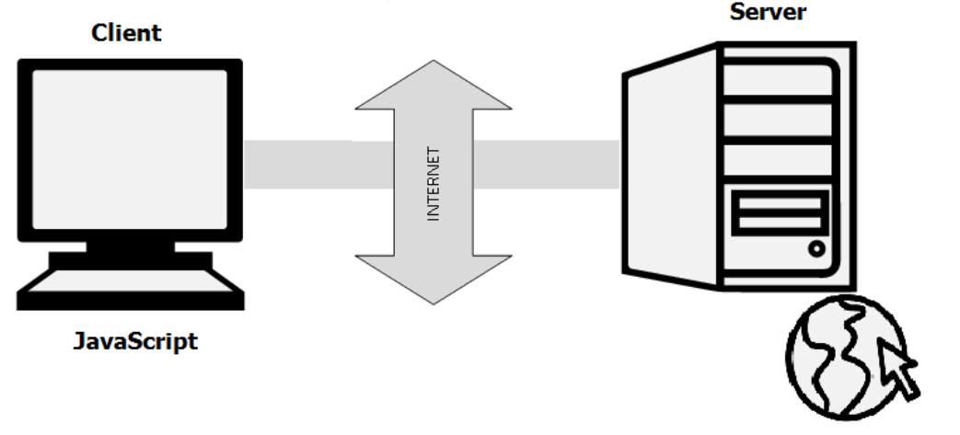
Client Side Scripting
All calculations are done by the computer of the visitor.
Downloaded by the browser, interpreted by the browser and executed by the browser, depending on the memory, CPU speed of visitors computer.
Example: Count books

Slide 6
Light Weighted
Validate user input before sending the page off to the server.
This saves server traffic, which means less load on your server.

Slide 7
Object based language
Allowed to create Objects, manipulate with object is called as Object Based Programming Language.
Allows us to create object so we call JavaScript as Object Based Programming Language.

Slide 8
Where it is used?
Used to create interactive websites.
Client-side validation
Dynamic drop-down menus
Displaying date and time
Build small but complete client side programs .
Displaying popup windows and dialog boxes
(like alert dialog box, confirm dialog box and prompt dialog box)

Slide 9
Questions
How to Run JavaScript?
Which Tools you need?

Slide 10
JS Syntax
JavaScript can be implemented using JavaScript statements that are placed within the <script>... </script>.
Place the <script> tags, containing your JavaScript, anywhere within your web page, but it is normally recommended that you should keep it within the <head> tags.
The <script> tag alerts the browser program to start interpreting all the text between these tags as a script.
A simple syntax of your JavaScript will appear as follows.
<script ...>
JavaScript code
</script>

Slide 11
Script tag Attributes
<script language="javascript" type="text/javascript">
JavaScript code
</script>
Language
This attribute specifies what scripting language you are using.
Its value will be JavaScript.
Type
This attribute is what is now recommended to indicate the scripting language in use and its value should be set to "text/javascript".

Slide 12
Script Position
There is a flexibility given to include JavaScript code anywhere in an HTML document. However the most preferred ways to include JavaScript in an HTML file are as follows −
Script in <head>...</head> section.
Script in <body>...</body> section.
Script in <body>...</body> and <head>...</head> sections.
Script in an external file and then include in <head>...</head> section.

Slide 13

JavaScript in <head>...</head> section
<html>
<head>
<script type="text/javascript">
<!-- function sayHello() {document.write("Hello World") } //-->
</script>
</head>
<body>
<input type="button" onclick="sayHello()" value="Say Hello" />
</body>
</html>

Slide 14

JavaScript in <body>...</body> section
<html>
<head>
</head>
<body>
<script type="text/javascript">
<!-- document.write("Hello World") //-->
</script>
<p>This is web page body </p>
</body>
</html>

Slide 15

JavaScript in <body> and <head> Sections
<html>
<head>
<script type="text/javascript">
<!-- function sayHello() {document.write(“How are you?") } //-->
</script>
</head>
<body>
<script type="text/javascript">
<!-- document.write("Hello World") //-->
</script>
<input type="button" onclick="sayHello()" value="Say Hello" />
</body>
</html>

Slide 16
Filename.js
JavaScript in External File
<html>
<head>
<script type="text/javascript" src="filename.js" >
</script>
</head>
<body> ....... </body>
</html>
function sayHello() {document.write("Hello World!") }

Slide 17
First JavaScript Script
<html>
<body>
<script language="javascript" type="text/javascript">
<!-- document.write("Hello World!") //-->
</script>
</body>
</html>

Slide 18
Whitespace and Line Breaks
Ignores spaces, tabs, and newlines that appear in JavaScript programs.
Use spaces, tabs, and newlines freely in program and free to format and indent programs in a neat and consistent way that makes the code easy to read and understand.

Slide 19
Comments in JS
Any text between a // and the end of a line is treated as a comment and is ignored by JavaScript.
Any text between the characters /* and */ is treated as a comment. This may span multiple lines.
JavaScript also recognizes the HTML comment opening sequence <!--. JavaScript treats this as a single-line comment, just as it does the // comment.
The HTML comment closing sequence --> is not recognized by JavaScript so it should be written as //-->.

Slide 20
Example
<script language="javascript" type="text/javascript">
<!-- // This is a comment. It is similar to comments in C++
/*
This is a multiline comment in JavaScript
It is very similar to comments in C Programming
*/
//-->
</script>

Slide 21
JavaScript Variables
<script type="text/javascript">
<!-- var money; var name; //-->
</script>
Declare multiple variables with the same var keyword
<script type="text/javascript">
<!-- var money, name; //-->
</script>

Slide 22
Semicolons are Optional
JavaScript, however, allows you to omit this semicolon if each of your statements are placed on a separate line.
<script language="javascript" type="text/javascript">
<!–
var1 = 10
var2 = 20
//-->
</script>
But when formatted in a single line as follows, you must use semicolons −
<script language="javascript" type="text/javascript">
<!-- var1 = 10; var2 = 20; //-->
</script>

Slide 23
variable initialization
<script type="text/javascript">
<!-- var name = "Ali"; var money; money = 2000.50; //-->
</script>

Slide 24
JavaScript Variable Scope
Global Variables − A global variable has global scope which means it can be defined anywhere in your JavaScript code.
Local Variables − A local variable will be visible only within a function where it is defined. Function parameters are always local to that function.

Slide 25
Example
<html>
<body onload = checkscope();>
<script type = "text/javascript">
<!–
var myVar = "global"; // Declare a global variable
function checkscope( )
{
var myVar = "local"; // Declare a local variable
document.write(myVar);
} //-->
</script>
</body>
</html>

Slide 26
Rules
Do not use reserved keyword
Not start with numerical (0-9)(123test)
Begin with letter or underscore character (_123test)
Case sensitive (Name and name different)

Slide 27
Function
Function allows user to define a block of code, given it a name and execute it as many times as user wants.
//defining a function
Function <function_name>()
{
//code to be executed
}
//calling a function
<function_name>();

Slide 28
Function Parameter
A function can have one or more parameters, which will be supplied by the calling code and can be used inside the function.
JavaScript is a dynamic scripting language, so a function parameter can have of any data type.
Function showmessage(firstname, secondname)
{
alert(“hello ” + firstname + “ ” + lastname);
}

Slide 29
Features of JavaScript
Object-based scripting language.
Giving the user more control over the browser.
Handling dates and time.
Detecting the user's browser and OS,
Light weighted.
Scripting language and it is not java.
Interpreter based scripting language.
Case sensitive.
Object based language as it provides predefined objects.
Every statement in javascript must be terminated with semicolon (;).
Most of the javascript control statements syntax is same as syntax of control
statements in C language.
An important part of JavaScript is the ability to create new functions within
scripts. Declare a function in JavaScript using function keyword.

Slide 30
Advantages of JS
Less server interaction
You can validate user input before sending the page off to the server. This saves server traffic, which means less load on your server.
Immediate feedback to the visitors
They don't have to wait for a page reload to see if they have forgotten to enter something.
Increased interactivity
You can create interfaces that react when the user hovers over them with a mouse or activates them via the keyboard.
Richer interfaces
You can use JavaScript to include such items as drag-and-drop components and sliders to give a Rich Interface to your site visitors.

Slide 31
Limitations of JS
Browser dependent
Source code of client-side scripts is not secured (can’t prevent user from seeing code)
Make the page bulky
Variable scope is limited to a single page
Can’t use client-side code to access local files, directories or databases

